Slide 1
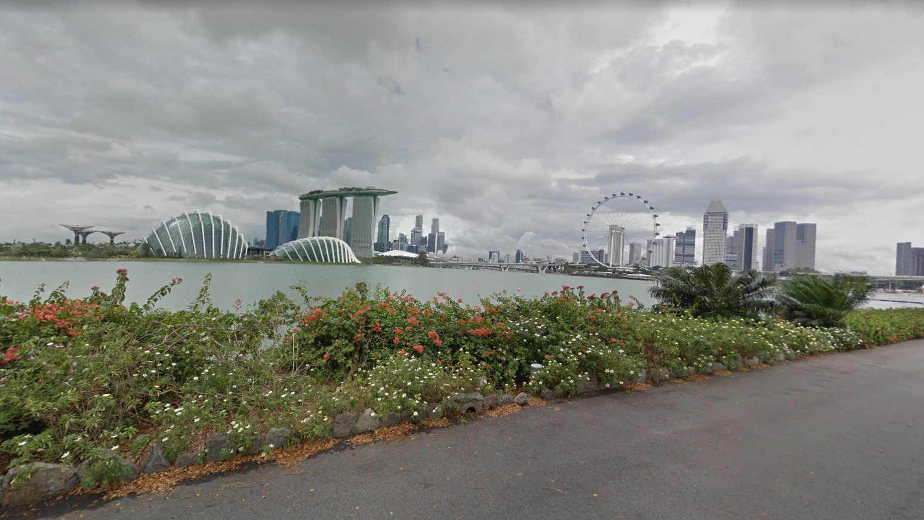
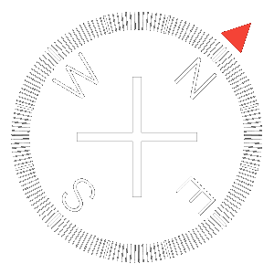
Current Location: Gardens by the Bay 1.286135, 103.870314

Slide 2




Singapore Flyer
x
2,062 Reviews
Overview
At 165 meters tall, Singapore Flyer is a masterpiece of urban architecture and engineering that showcases not only the mesmerizing cosmopolitan cityscape of the tropical Lion City, but even the surrounding islands of Indonesia and parts of Malaysia in all their glory. In addition to offering panoramic views of Singapore's cosmopolitan cityscape, guests can also indulge in a flute of champagne, or savor the iconic Singapore Sling whilst hosted in a special themed capsule. Diners seeking both privacy and luxury can opt for a multi-sensory treat unlike any other with our Premium Sky Dining Flight, complete with a four-course dinner and an in-flight host.
Read Reviews
Write Review
How to Get There

